Slide 1
Gamification
CSCI 3002 Fall 2018

Slide 2
Gamification: Discussion (5 minutes)
Talk to your neighbor
Discuss a board, video, etc. game that you have been addicted to
Why was it so engaging?

Slide 3
Gamification
Use of game elements in things not usually considered to be games
Leverage psychological effects of game design

Slide 4
Why are games so awesome?
Intermittent rewards
Signs of progress
Social status
Engaging story or theme
http://www.economist.com/blogs/babbage/2014/02/electronic-entertainment

Slide 5
Designing for behavior change
Technology can be a powerful motivator
Can we encourage beneficial activities?

Slide 6
Motivating behaviors: positive and negative

Slide 7
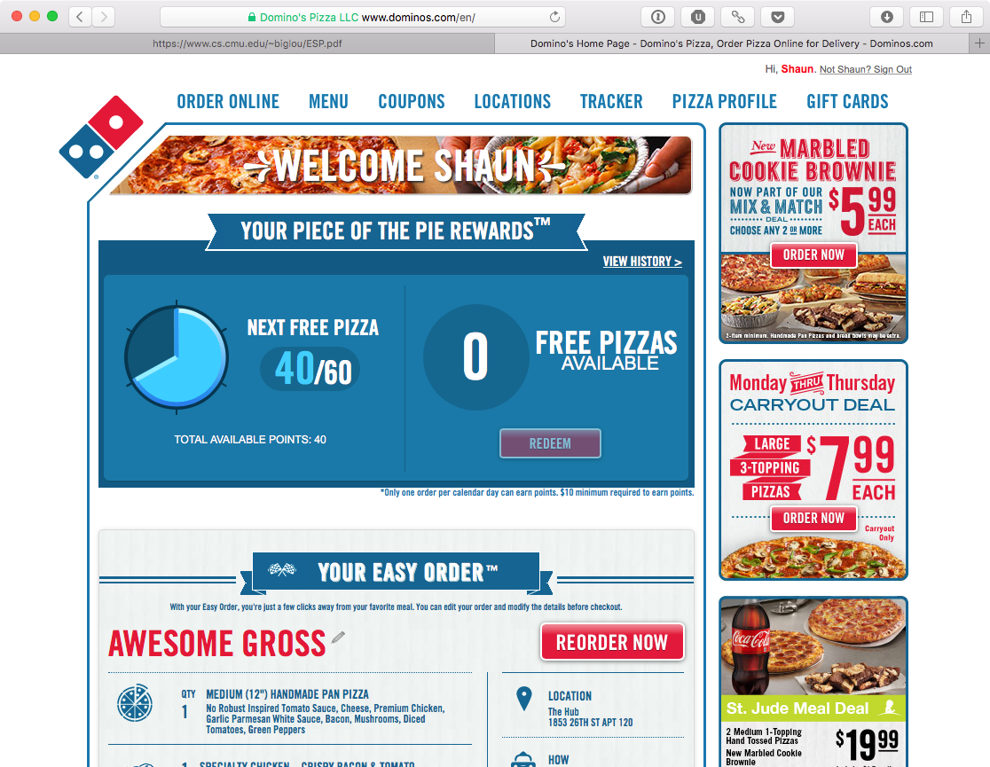

Slide 8
Examples

Slide 9
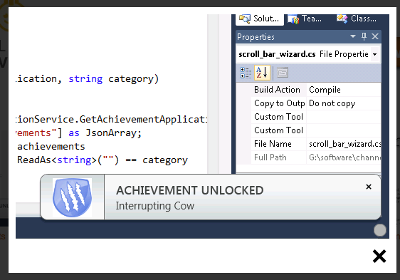
Visual Studio achievements
https://channel9.msdn.com/achievements/visualstudio

Slide 10
UbiFit Garden and Fitbit
S. Consolvo et al, UbiFit Garden

Slide 11
Fitbit social

Slide 12
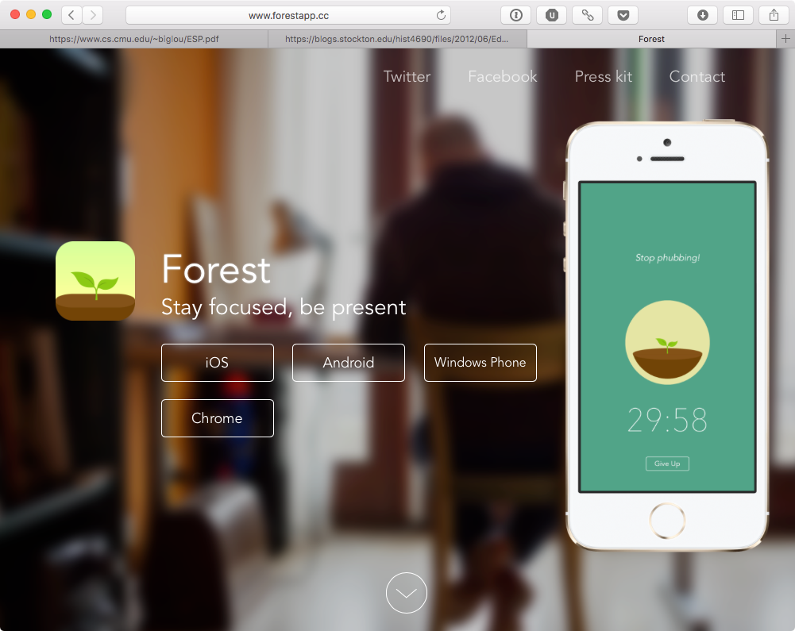
Forest for iOS
http://www.forestapp.cc

Slide 13
Zombies, Run!
https://youtu.be/GyFqZtKvya0?t=90

Slide 14
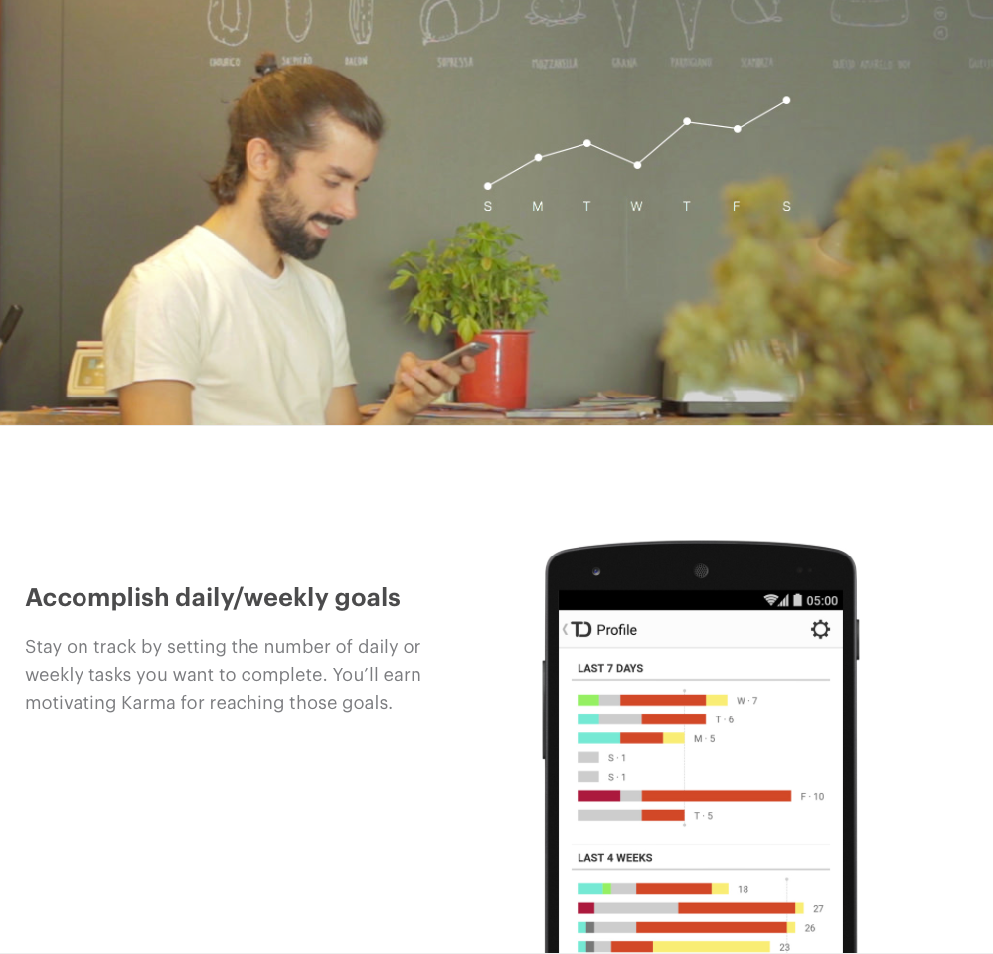
Keeping score with Todoist
https://todoist.com/karma

Slide 15
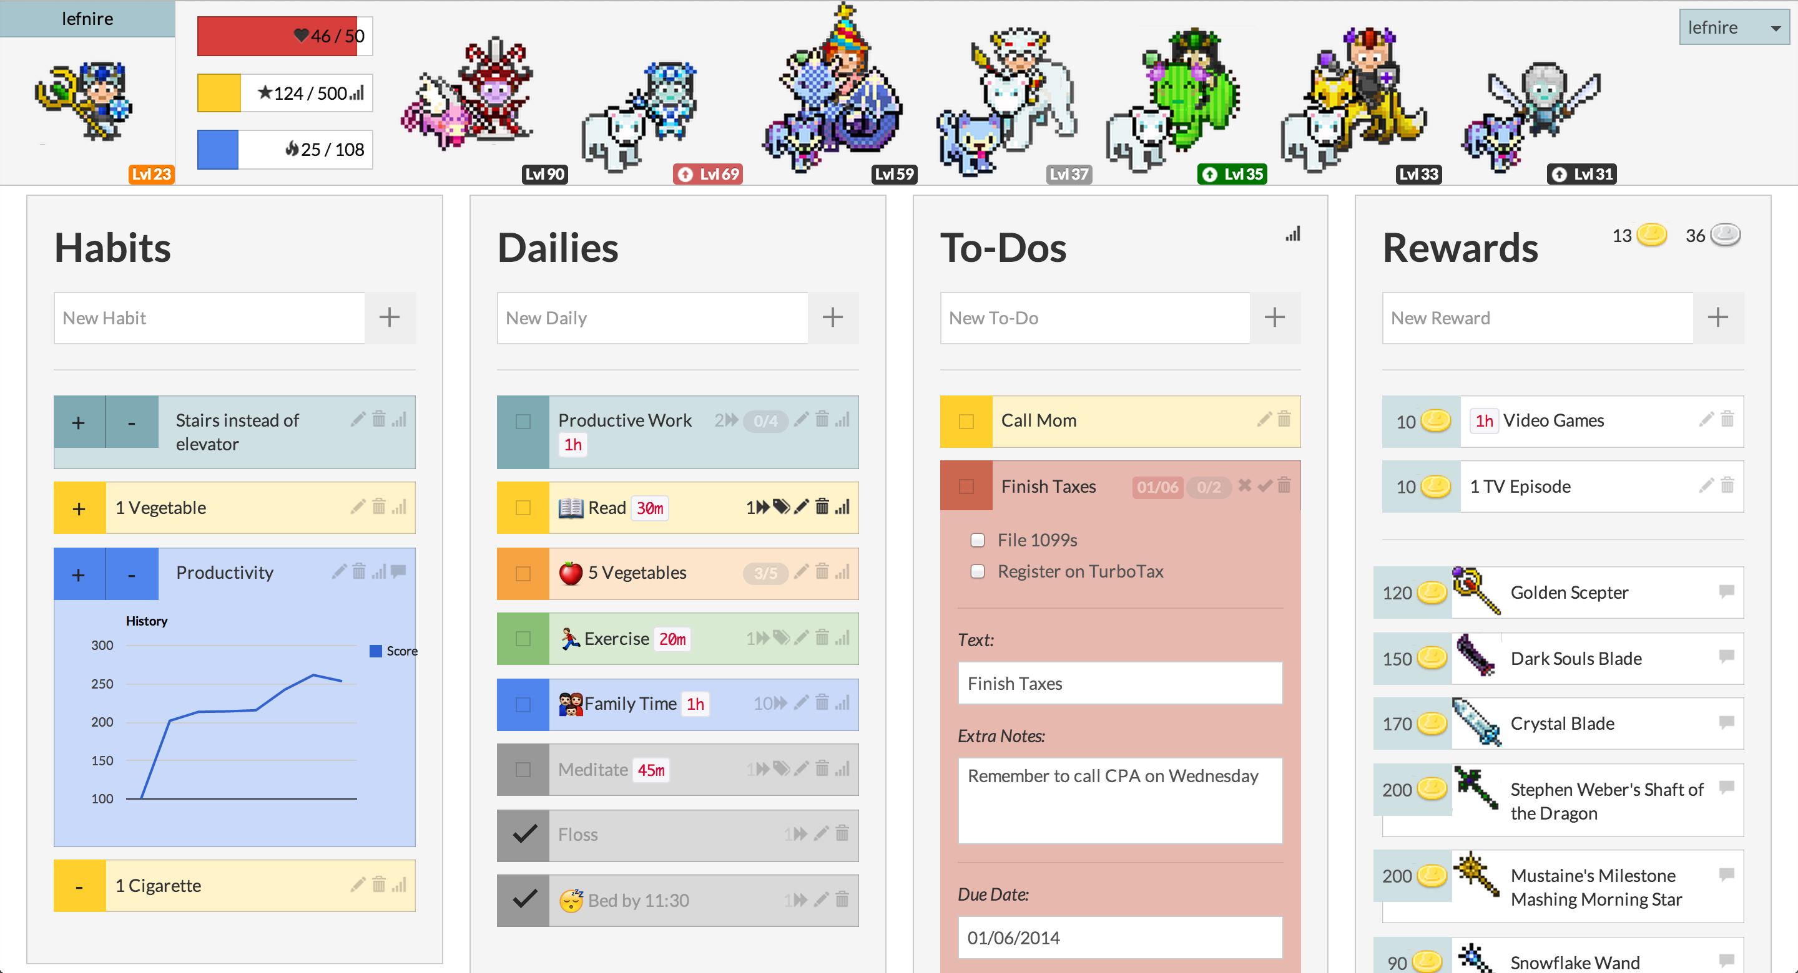
Habitica/HabitRPG
http://habitica.com

Slide 16
Games with a purpose

Slide 17
Example
Developing a music tagging system
Listen to this music clip
With a partner, generate tags to help search/browsing
Group with the most tags gets karma

Slide 18
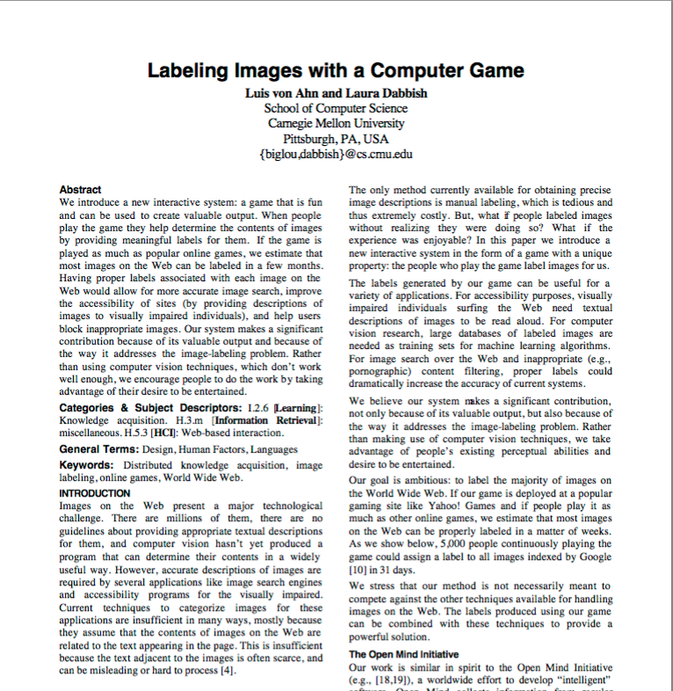
The ESP Game

Slide 19
The ESP Game

Slide 20
Games with a purpose
Motivate people to do useful things by making it a game

Slide 21
Other resources
Gamification wiki: https://badgeville.com/wiki/
Stanford persuasive technology lab: http://captology.stanford.edu

Slide 22
Gamification activity
Let's gamify registering for courses
First, we'll pick a goal
What do we want our student body to learn?
Paper prototype a course registration app that will help support that goal

Slide 23
Registration problems
Load balancing of classes&classrooms (within or between semesters)
Supporting cohorts
Incentivize meeting with an advisor/plan ahead
Reducing squatting

